Slide 1
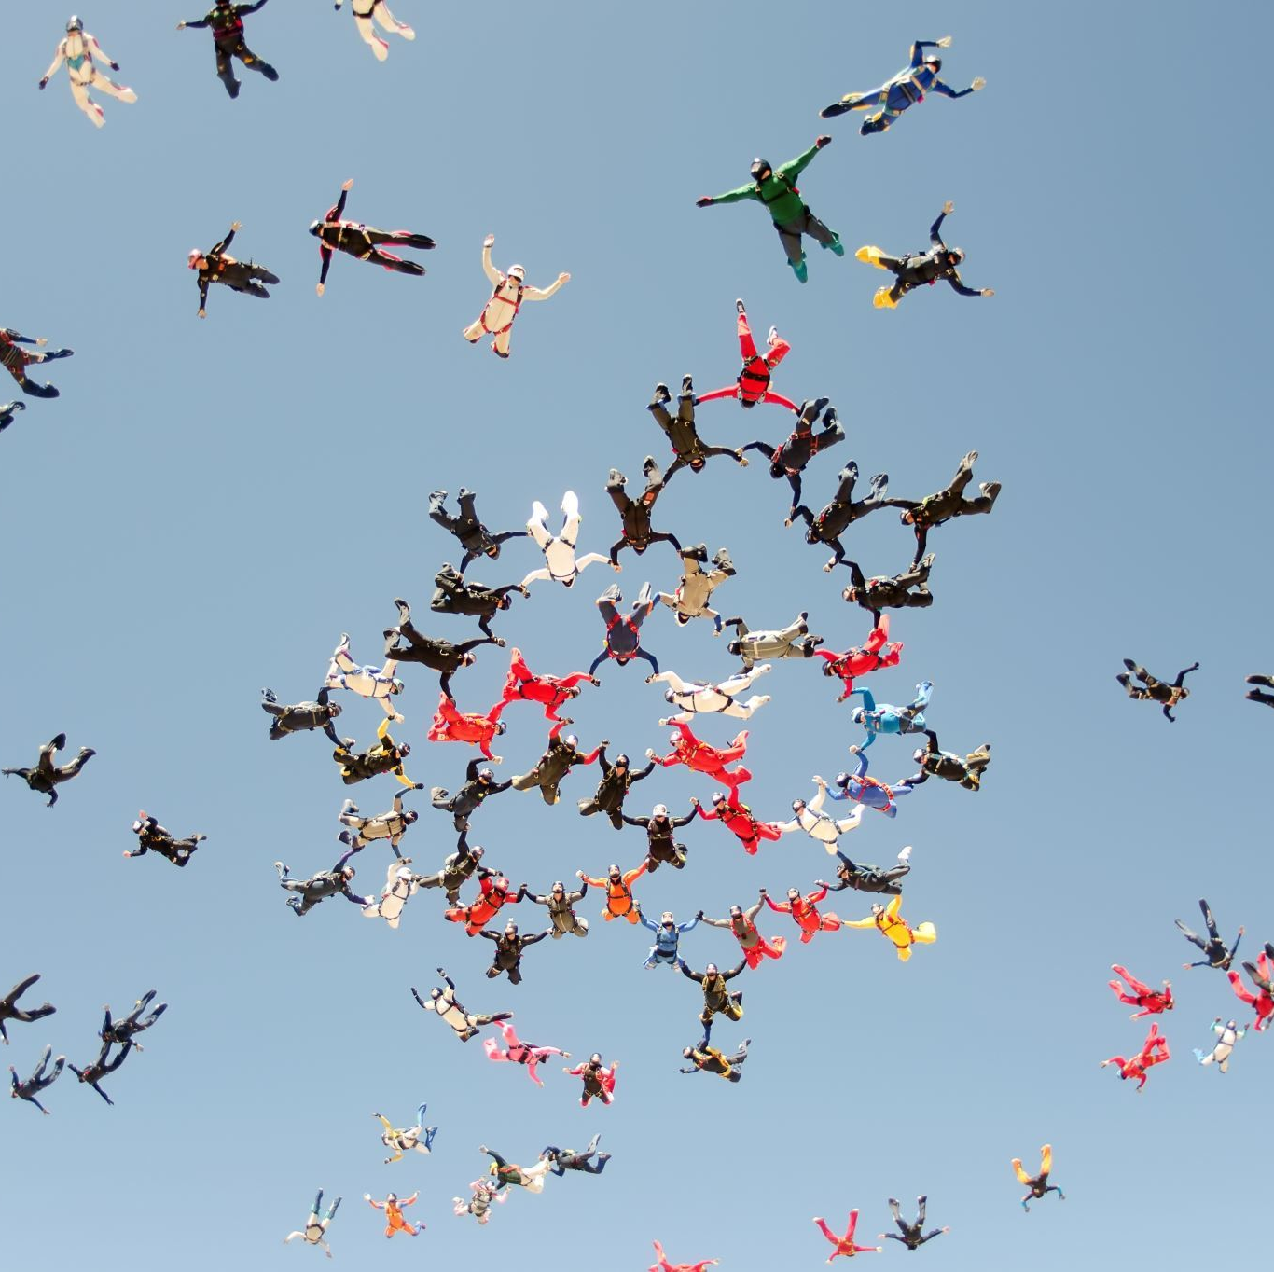
DATA ANALYTICS WITH COGNOS
TEAM LEADER
SNEHA.L
TEAM MEMBERS
1.LALITHA.T
2:HARI PRABHA.V
3.GAYATHRI.R
4.AMUTHA MALAR.R
5.NIKETHA.S

Slide 2
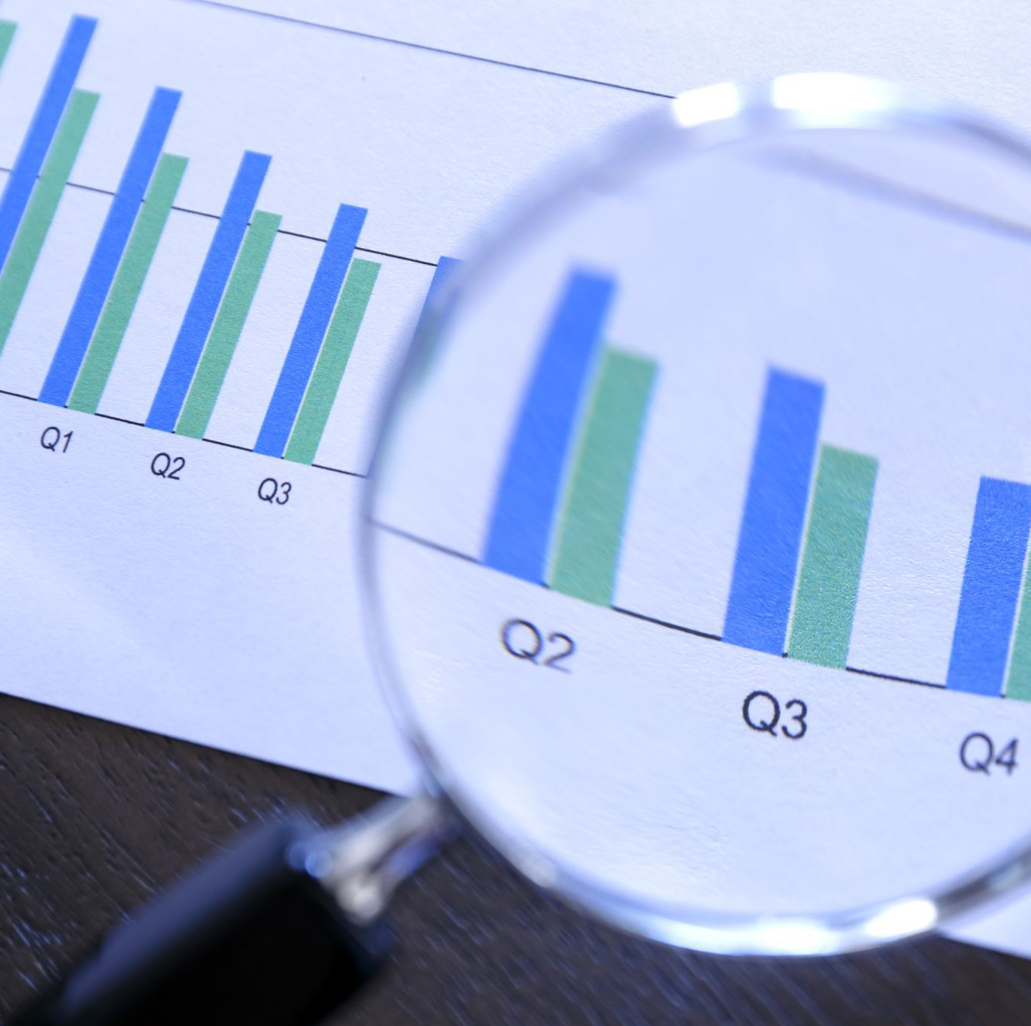
DOMAIN
PRODUCT SALES ANAlYSIS
Sales analysis is reviewing your sales data to identify trends and patterns.
Sales data can help you make better decisions about your product, pricing, promotions, inventory, customer needs other aspects of your business.
Sales analysis can be as simple as reviewing your sales figures regularly.

Slide 3
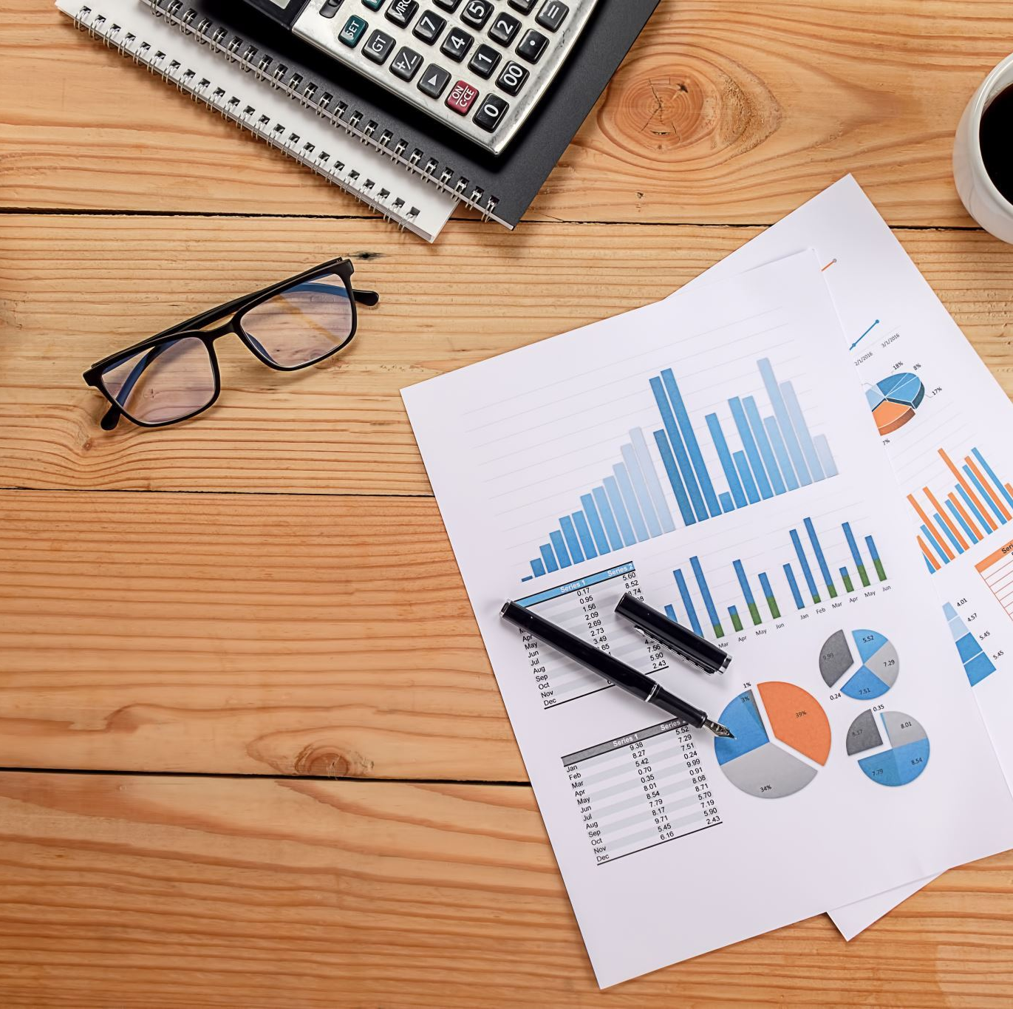
OBJECTIVES
Increase revenue by selling higher quantity at optimal selling price​.
Increase sales by improving marketing effectiveness through understanding of the customers’ buying habits.​
Increase profit by discontinuing products with dissatisfying revenue

Slide 4

OVERVIEW
For retailers, understanding the sales and customers’ buying habits is highly valuable.
Insights about customer satisfaction demographics and buying price can drive decisions for marketing, sales and even inventory management.

Slide 5
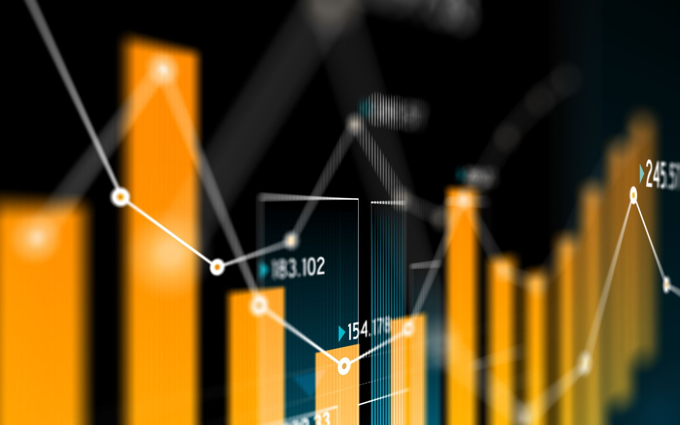
GOLES
The purpose of product analysis is to provide manufacturers with the deliverables necessary to understand and perfect the product.
The analysis ensures that the product is market ready, reaches the intended target market and achieves the desired results.

Slide 6

DESING THINKING
Design Thinking is a methodology that provides a solution-based approach to solve problems.
It focuses on understanding the user perspective, with a human-centered point of view. The power of this methodology is the possibility to test quickly if an idea, solution or enhancement can bring real results to our customers.

Slide 7
Sales Data Is Important for Analyzing Sales Data Is Important for Small Businesses
Sales analytics support decisions around which products to focus on, where to sell, and how best to reach customers.
Many sales analysis tools exist to help small businesses improve and grow their businesses.
You can leverage customer relationship management (CRM) and point of sale (POS) software to perform sales analysis with ease.
This article is for small business owners who want to learn how to glean information from their sales data.

Slide 8
IMPORTANCES
Product analytics enable an organization to track and analyze its users' journeys -- from user activation through all other phases of use -- to understand what makes them engage with and return to the product. This also helps organizations understand the value that the product provides to customers.
Product analytics is typically used by technology companies that provide web and mobile applications; however, it is also used by e-commerce companies whose primary revenue comes from digital properties. Within these companies, product leaders, designers and developers use the data gathered through product analysis to inform their decisions. Many market leaders, including Uber, Spotify and Netflix, use product analytics to improve their services.

Slide 9
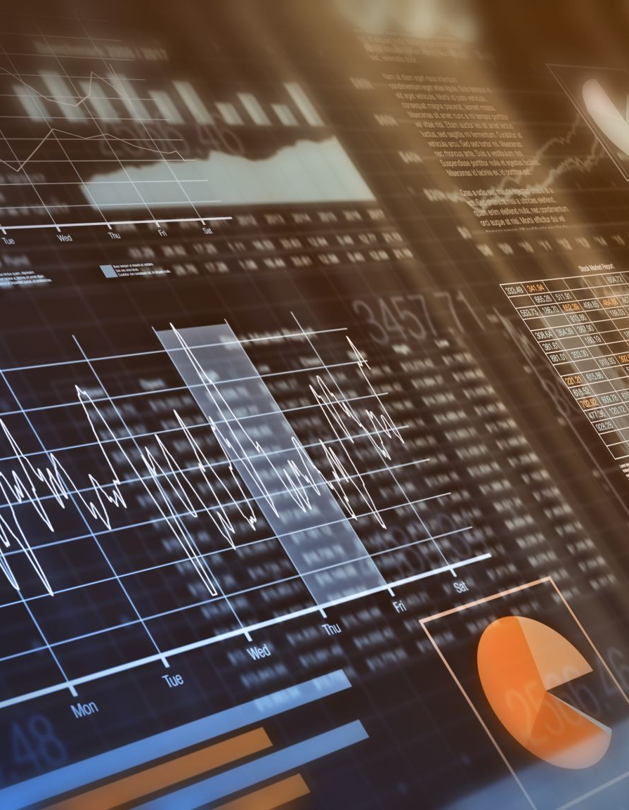
Product Analysis Methods
Several product analysis methods help you understand a product in detail.
Here are the most popular product analysis methods to get you started:
KJ method
SWOT Analysis
Value chain analysis
PESTLE analysis
Business model analysis
Competitive product analysis

Slide 10
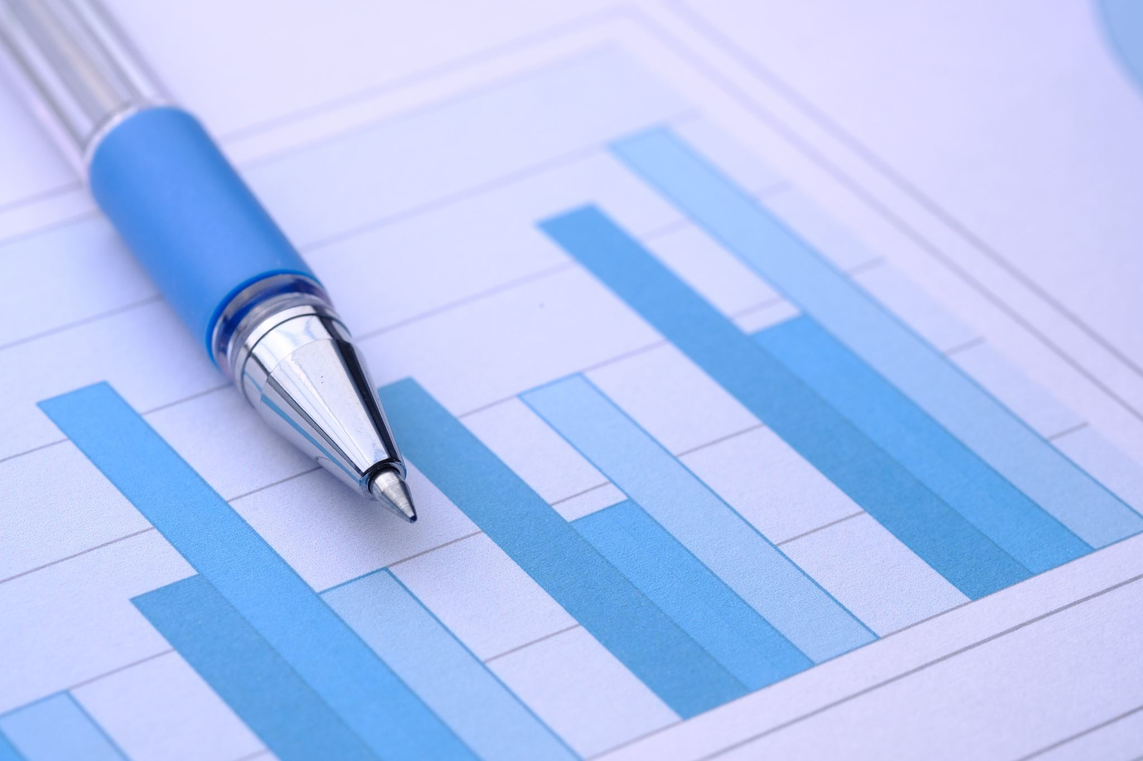
PRODUCTS ANALYSIS TECHNIUES
Product analysis is “the process of gathering, defining, and analyzing data about a product or service to make better decisions.”
To create products that fit the needs of your target market, you need to have a clear understanding of what those needs are. This is where product analysis comes

Slide 11
PRODUCT TESTING
Another critical step in product analysis is product testing.
This involves putting the product through its paces to see how it performs in different scenarios.
For our fitness tracker example, you might test how well it tracks activity, monitors heart rate, and records data.

Slide 12
EXAMPLES
What is the material of the t-shirt? The quality? And what occurs with that material after it is washed.
What colors are on the t-shirt? Will the colors bleed? If printed on, is the print ink of higher quality or not?
Where is the t-shirt manufactured and is it easy to manufacture the product there?
What are the capabilities of the manufacturer for future orders?
What is the minimum order quantity (MOQ)?
Is the manufacturer certified and audited for proper compliance?

Slide 13

THANK YOU

